Slide 1
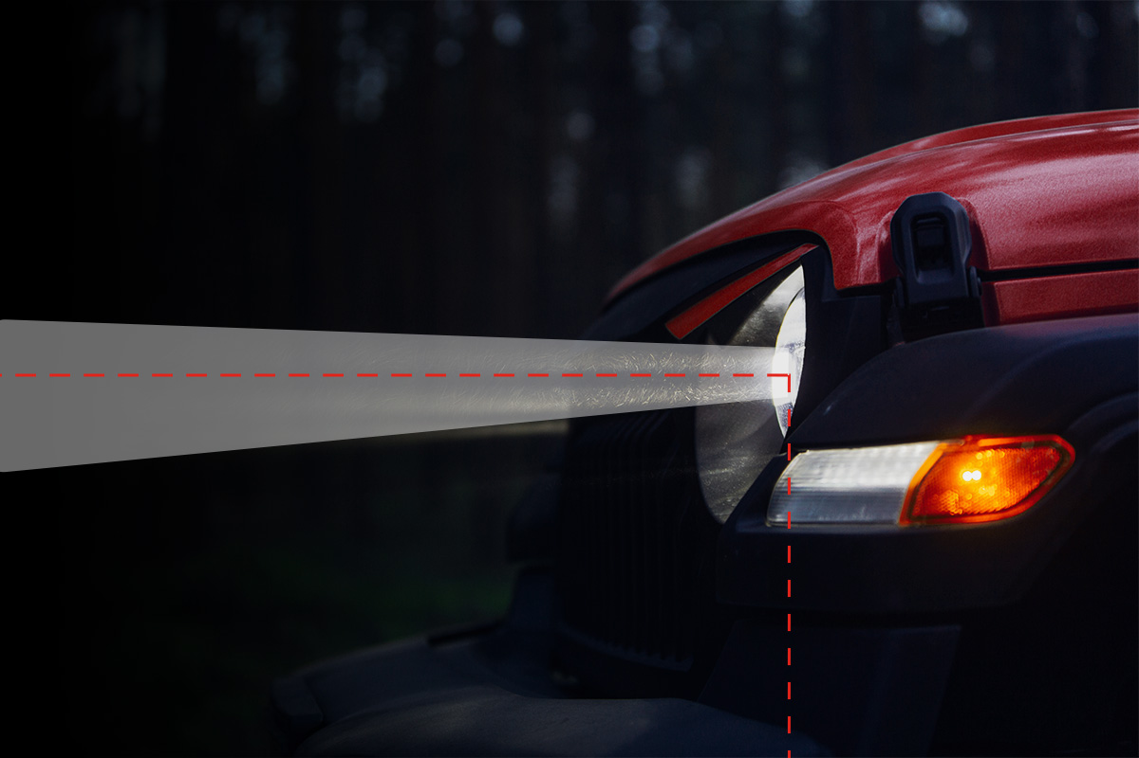
REAL-TIME VEHICLE DETECTION AND ADAPTIVE HEADLIGHT SYSTEM
Presented by:
PRIYANSHU SINGH
P.SAI CHARAN
R.SIVA KUMAR
SAI KUMAR B
Guided by:
Sarath sir

Slide 2
CONTENTS
INTRODUCTION
PROBLEM STATEMENT
COMPONENTS
BLOCK DIAGRAM
WORKING
PROTOTYPE
CONCLUSION

Slide 3
INTRODUCTIONRODUCTION
The Real-Time Vehicle Detection and Adaptive Headlight System is an innovative project designed to improve road safety and driving comfort. By using advanced sensors and real-time data processing, this system detects nearby vehicles and automatically adjusts the headlights to optimize visibility while preventing glare for other drivers. The adaptive headlights adjust the beam direction based on factors like vehicle speed, road curvature, and traffic conditions. This ensures better illumination in low-light environments, enhancing safety. Technologies such as ultrasonic sensors, LDR,Flame sensor ,LM393 and ESP32 microcontroller systems are integrated to create an intelligent solution for modern vehicles.

Slide 4
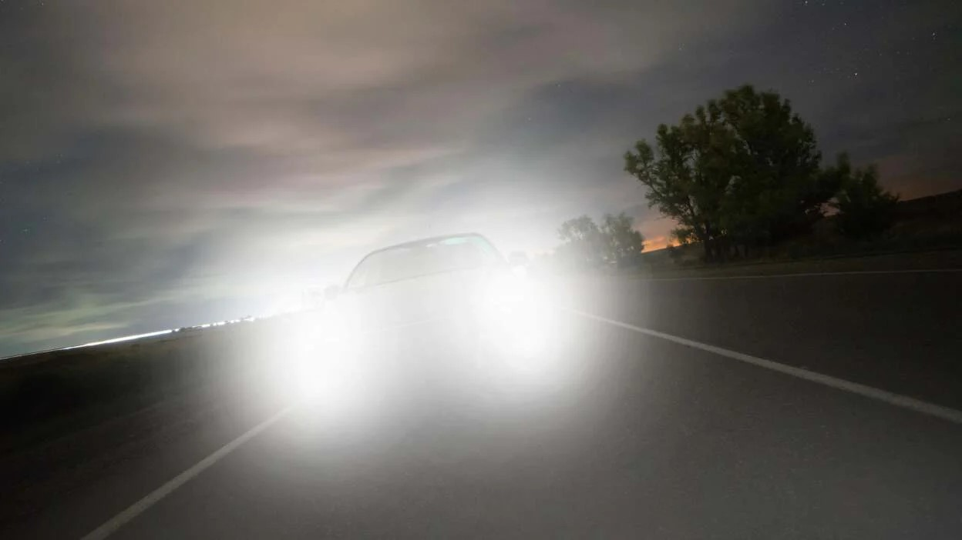
WHAT IS THE PROBLEM
The project addresses challenges like visibility issues caused by oncoming high-beam headlights at night and poor road visibility during foggy or rainy conditions. It ensures dynamic adjustment of headlights for real-time brightness and beam control. Sensors must respond quickly to sudden changes in light and weather. The system's durability and consistent performance are crucial for enhancing road safety.

Slide 5
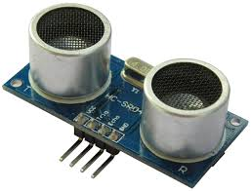
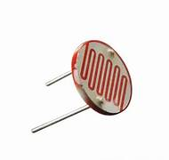
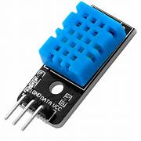
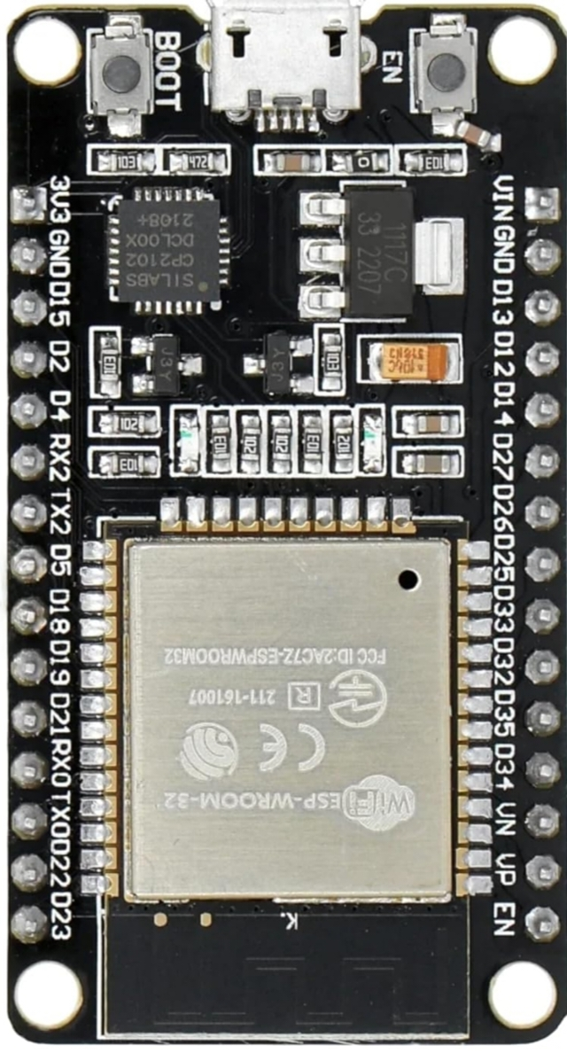

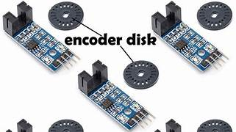
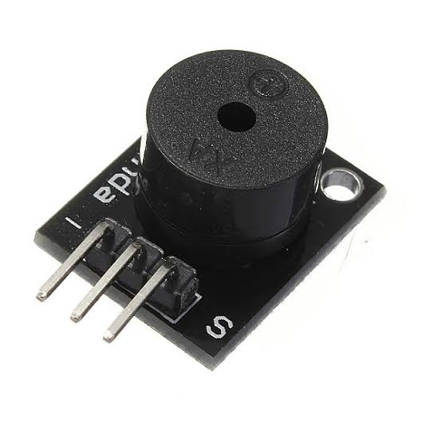
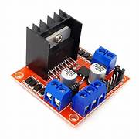
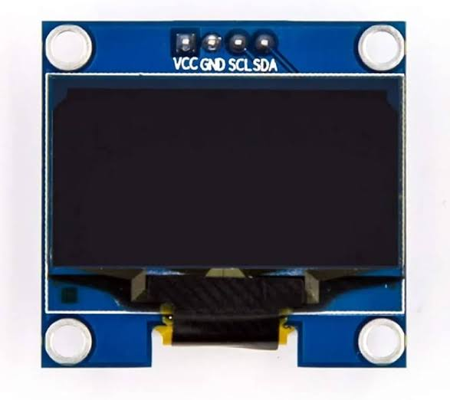
COMPONENTS
ESP32 Microcontroller
Sensors :
Ultrasonic Sensor(HC-SR04)
DHT11
LDR(light dependent resistor)
LM393
L298N Motor driver
Actuators :
Buzzer
LEDS
OLED Display
Software Implementation :
C Programming using Arduino IDE

Slide 6
Block Diagram
L298N MOTOR DRIVER
ULTRASONIC SENSOR
LEDS
LDR
DTH11
OLED
ESP 32
Twilio
LM393
BUZZER
FLAME

Slide 7
WHY ESP32 The ESP32 is used in your project due to its powerful dual-core processor, built-in WiFi and Bluetooth capabilities, and extensive GPIO support, making it ideal for real-time vehicle detection and adaptive headlight control. Additionally, its compatibility with multiple sensors, including the ultrasonic, flame, and DHT sensors, allows efficient data acquisition and processing. The ESP32 also supports Twilio integration, enabling real-time alerts and notifications for critical events like fire detection or abnormal conditions.

Slide 8
WORKING
System initializes – ESP32 starts, sensors activate.
DHT11 Sensor: Detects temperature and humidity to identify foggy or rainy conditions and adjust headlight brightness accordingly.
LDR (Light Dependent Resistor): Measures ambient light intensity to automatically turn on headlights in low-light conditions.
Ultrasonic Sensor: Detects oncoming vehicles or obstacles and triggers automatic switching between high and low beams to avoid glare.
LM393 Module: Ensures precise brightness control of LEDs based on sensor data for optimized lighting.
L298N Motor Driver: Controls servo motors for adjusting the headlight beam's direction dynamically.
LEDs: Provide adjustable illumination for headlights, dynamically controlled based on environmental and traffic inputs.

Slide 9

TWILIO Twilio operates on a cloud platform, removing the need for physical servers. It simplifies complex communication tasks for developers with easy-to-implement tools. Twilio supports global communication, enabling services to reach users worldwide It is commonly used for customer support, marketing campaigns, and secure user authentication. Twilio offers services like SMS , Voice calls, Video calls, email services etc ..

Slide 10
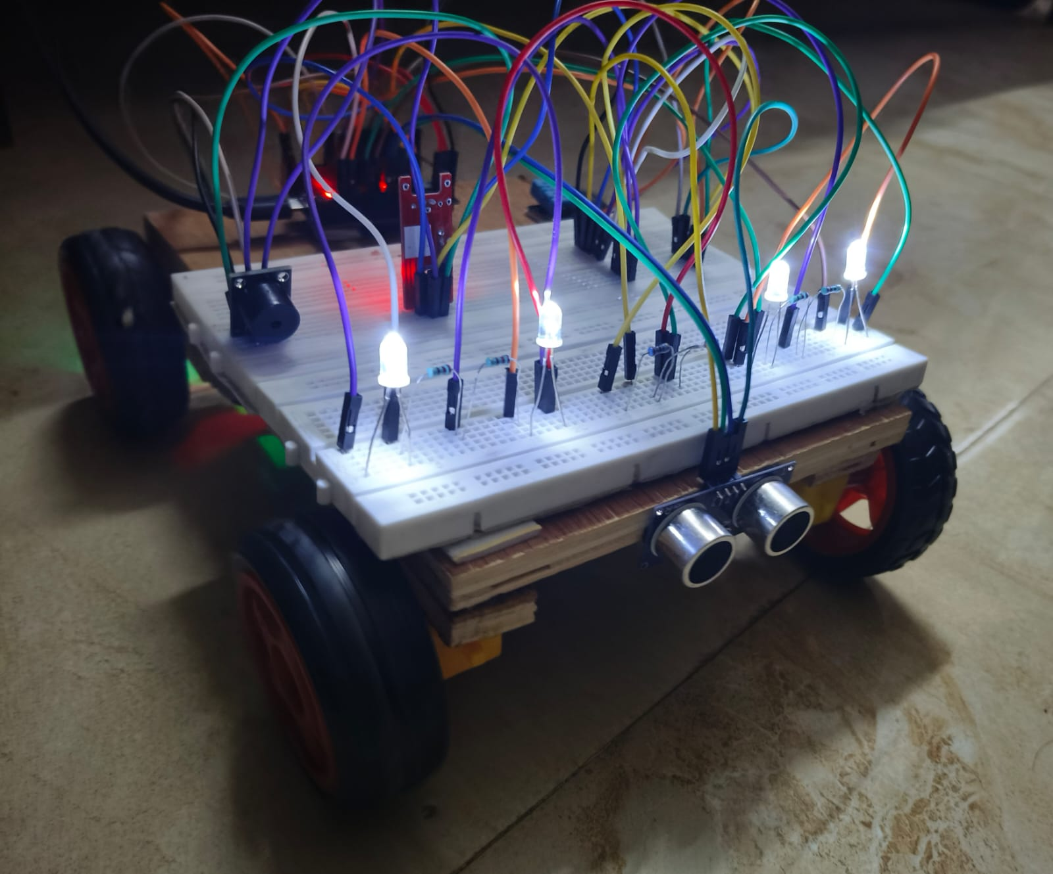
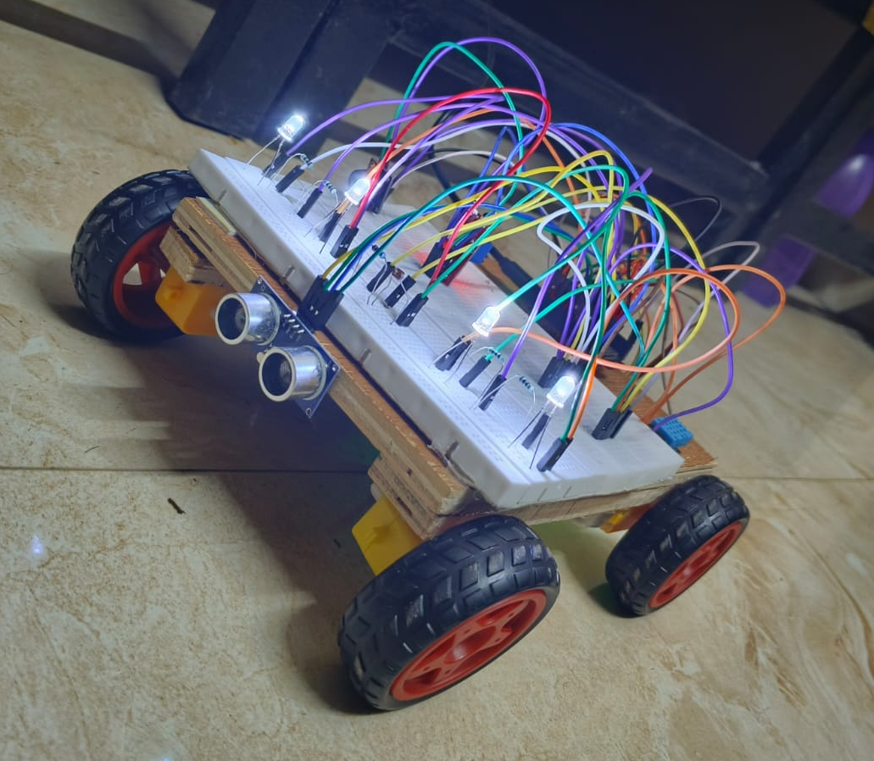
PROTOTYPE

Slide 11
CONCLUSION
The Real-Time Vehicle Detection & Adaptive Headlight System is an innovative solution designed to enhance road safety and driving comfort, particularly during night time and adverse weather conditions. By integrating sensors like DHT11, LDR, Ultrasonic, and advanced components such as LEDs, LM393, and L298N, the system dynamically adjusts headlight brightness, beam direction, and mode based on real-time environmental and traffic data. The use of ESP32 for cloud-based monitoring ensures proactive safety alerts and efficient traffic management.

Slide 12

THANK YOU!

